Slide 1


Minor Project
Title:
Identification Of Speech Emotion To Detect An Users Mood
Presented by:
Nidhish Pandey, R2142201829, CSE AIML
Om Agarwal, R2142201904, CSE AIML
Rupesh Kumar, R2142201838, CSE AIML
Guided by:
Dr. Sanjeev Kumar
School of Computer Science

Slide 2
Content
Introduction
Literature Review
Problem Statement
Basic analogy
Ideology
Building of model
Results and outputs
Working Model
Challenges and Conclusion
References

Slide 3
Introduction
Automatic speech recognition is basically the process of converting spoken words into text form, basically transcribing what someone is speaking. It is a challenging problem to solve, but you can see various examples of this technology at work nowadays. Since emotions help us to understand each other better, a natural outcome is to extend the understanding to computers. Speech recognition is already in our everyday life, thanks to smart mobile devices that are able to accept and reply to synthesized speech. Speech emotion recognition could be used to enable them to detect our emotions as well.
If you have an android phone and just say ‘OK Google”, you will see a window open up at the bottom. If you now speak more words, you will see that the app will try to identify what you are speaking. It won't get perfect the first time, and it probably will show some intermediate words as you continue to speak. But, in the end, the technology will recognize your speech.

Slide 4

Problem Statement
Emotion detection has become one of the biggest marketing strategies in which mood of the customer plays an important role. So to detect the current emotion of the person and suggest him the appropriate product or help him accordingly will increase the demand of the production the company.

Slide 5
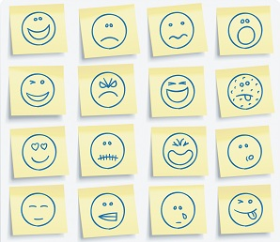
Humans have the natural ability to use all their available senses for maximum awareness of received messages. The emotional detection is natural for humans but it is very difficult task for machines. Detecting emotions is one of the most important strategy in today’s world. For this reason, we decided to do a project where we could detect a person’s emotions just by their voice which will let us manage many AI related applications.
Some examples could be - →Slowing down a smart car when one is angry or fearful. →Including call centres to play music when one is angry on the call.

Slide 6
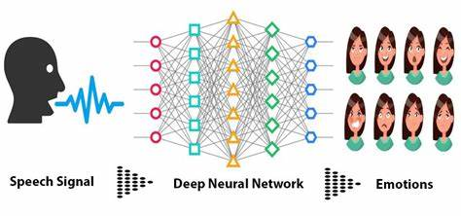
Basic Analogy Of the project
Analogy is we have a speech signal which is passed to a deep neural network and the deep neural network will determine the predicted emotions behind the speech.

Slide 7
Ideology Behind The Project
The idea behind this project was to build a machine learning model that could detect emotions from the speech we have.
So why not have a emotion detector that will gauge your emotions and in the future recommend different things based on your mood. This can be used by multiple industries to offer different services like
Automotive industry can detect the persons emotions and adjust the speed of autonomous car as required to avoid any collisions.
Marketing company suggesting us to buy products based on our emotions.

Slide 8

Dataset Used
For training of our model we uses a custom dataset that we created by using the three already existing datasets. Our dataset contains 11,178 audio files which are divided into 6 emotions: Happy, Angry, Disgust, Fear, Neutral and Sad.
RAVDESS:
This dataset includes around 1500 audio files input from 24 different actors. 12 male and 12 female where these actors record short audios in 8 different emotion.
TESS:
The TESS Dataset is a collection of audio clips of 2 women expressing 7 different emotions (anger, disgust, fear, happiness, pleasant surprise, sadness, and neutral).
3. CREMA:
CREMA-D is a data set of 7,442 original clips from 91 actors. These clips were from 48 male and 43 female actors between the ages of 20 and 74 coming from a variety of races and ethnicities (African America, Asian, Caucasian, Hispanic, and Unspecified). Actors spoke from a selection of 12 sentences.

Slide 9

Dataset Used
4. SAVEE:
The SAVEE database was recorded from four native English male speakers (identified as DC, JE, JK, KL), postgraduate students and researchers at the University of Surrey aged from 27 to 31 years. Emotion has been described psychologically in discrete categories: anger, disgust, fear, happiness, sadness and surprise. A neutral category is also added to provide recordings of 7 emotion categories.
5. ASVP-ESD
The Audio, Speech, and Vision Processing Lab Emotional Sound database (ASVP-ESD).
This dataset contains audio files regrouped in 130 folders; The data are organized as follows: Meanwhile some are mixed, odd folder numbers are mainly for females, and even for males (total size: 2 GB).
As it's a realistic dataset some folders contain dialog or several people interacting in the audio; Speech and non-speech Emotional sounds include boredom(sigh,yawn), neutral, happiness (laugh, gaggle), sadness(cry), anger, fear (scream, panic), surprise(amazed,gasp), disgust(contempt), excite(Triumph,elation), pleasure(desire), pain(groan), disappointment; A total of 12 different emotions plus breath. 2 levels of intensity were used for the database (normal and high).

Slide 10
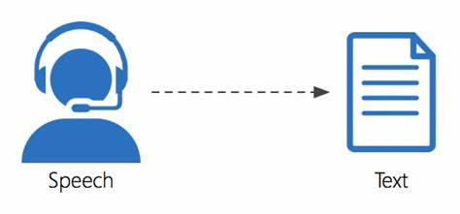
Speech to text translation using speech Recognition API
Initially we tested the audio by translating it back into the text mode using speech emotion API to know what the audio is all about.

Slide 11

Analysing audio signals
Second step is to test out the audio files by plotting out the waveform spectrogram to see the sample audio files.

Slide 12
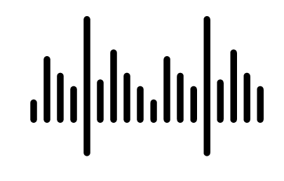
Masking and Cleaning of audio files
Next step is to clean the audio files by lowering down the sample rate and removing the unwanted noise around the raw audio via MASKING.

Slide 13
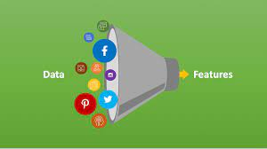
Feature Extraction
The next step involves extracting the features from the audio files which will help our model learn between these audio files. For feature extraction we make use of LibROSA library in python which is one of the libraries used for audio analysis.
Also there are labels of EMOTIONS defined, when the clean dataset is loaded with the calling of Feature Extraction process, every audio is classified into the labels predefined.

Slide 14
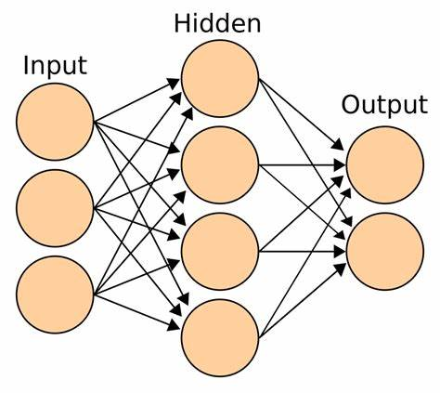
Building the model
Since the project is a classification problem, Multilayer Perceptron seems the obvious choice. We chose this model to predict the right emotions.
This classifier connects to a neural network. Unlike other classification algorithms such as Support Vector or Naïve Bayes classifier, MLP classifier relies on an underlying neural network to perform the task of classification.

Slide 15
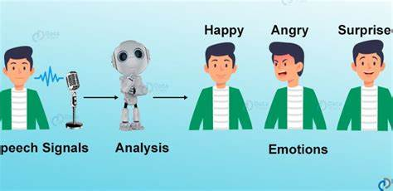
Predictions:
After tuning the model, tested it out by predicting the emotions for the test data. Following the splitting of training and testing data to save the model. Model is loaded again to predict the test data and store its result in .csv file along with its labels for mapping individual results to its wav file name.

Slide 16
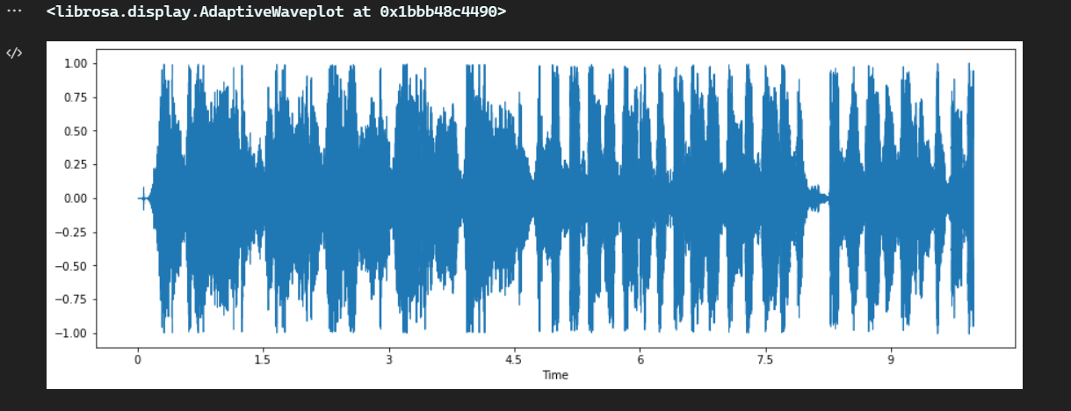
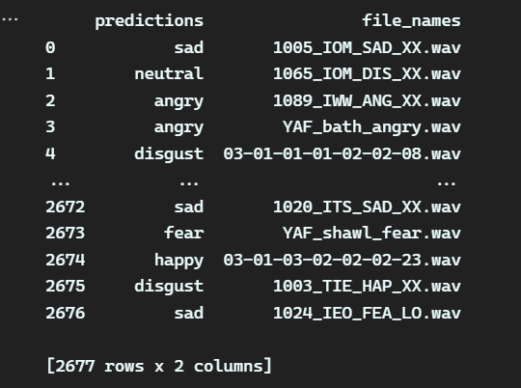
Outputs:
We have tested our model on test data and got an accuracy score of 0.822.

Slide 17

Live Demo For Prediction
Now we can record the voice of any user via microphone and can then save it as a .wav file. So that later we can load our model to predict the result out of that particular .wav file.

Slide 18
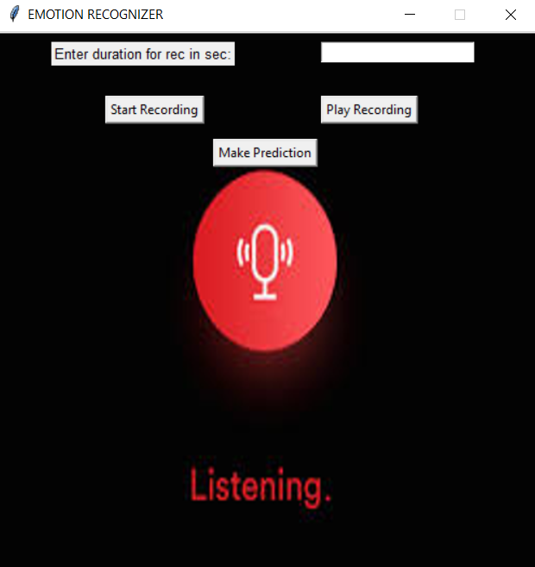
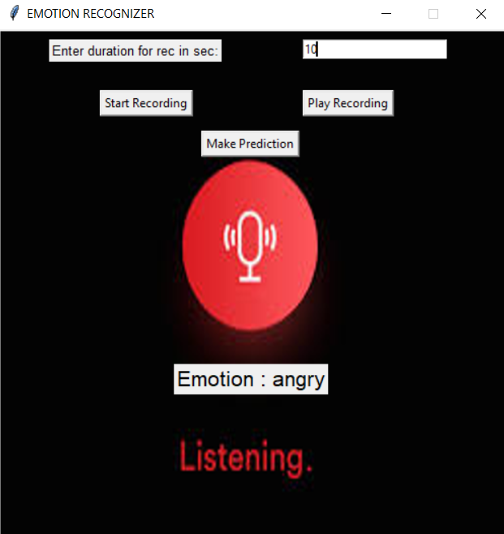
GUI Interface

Slide 19
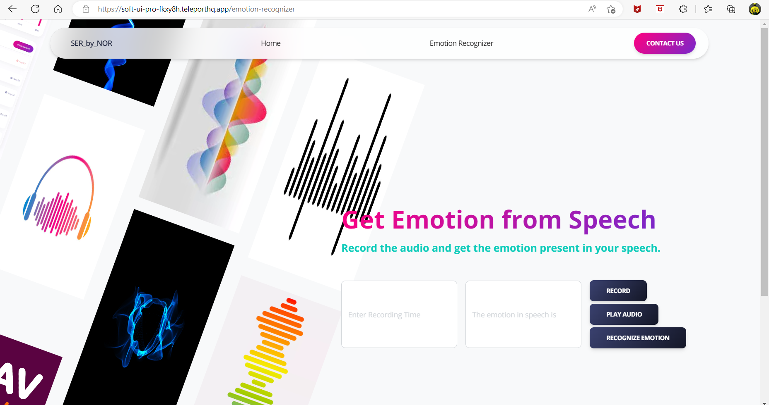
Web User Interface

Slide 20
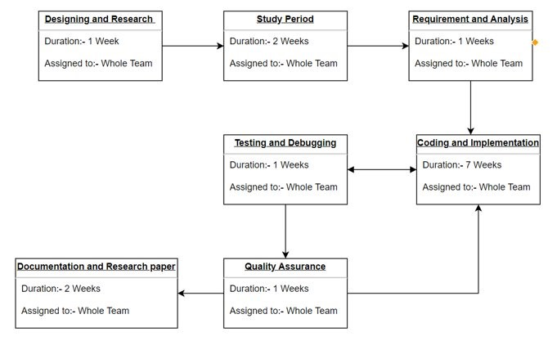
Pert Chart

Slide 21
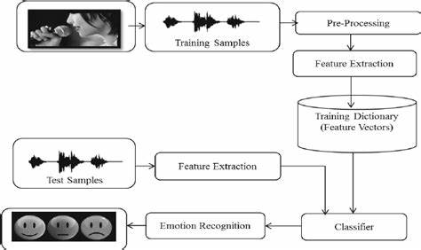
Technical Diagram

Slide 22
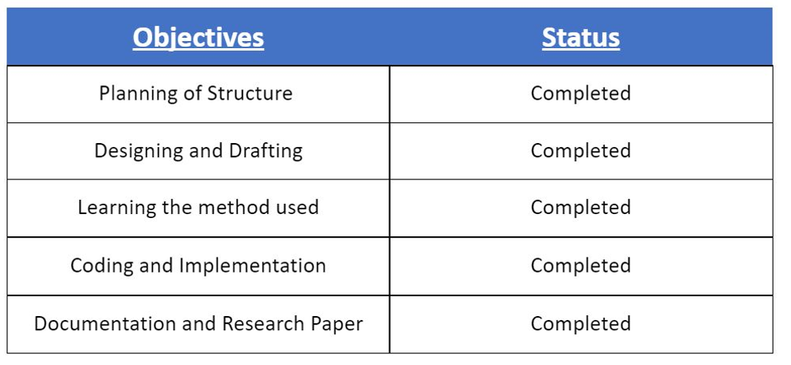
Attained Deliverables

Slide 23
SWOT:
Strength :
Current need of the market
Useful in managing other AI application
Weakness :
Fault intolerant.
Accuracy may depends on the accent of the user.
Opportunity :
A new boost for automotive industry.
Boon for product based companies
Threat :
Some researches are ongoing to achieve this objective more efficiently.

Slide 24
Challenges
Existing Datasets-
There are several open and paid datasets available for Speech Emotion Recognition. But there are shortcomings related to them.
These datasets are extraordinarily confined in covering languages, audio system, genders, a while, dialects, etc. The trouble of training, validating, and checking out on a restrained dataset is the abundance of overconfidence (overfitting) and tough failure within the area.
There isn't any standard set of labels for human emotions! These datasets all use a barely one of a kind set of emotions.
Being angry in a web recreation differs from being indignant with a customer service agent. A worldwide definition of what an emotion seems like seems really futile. Check the picture of Feelings Wheel beneath for a visual rationalization.

Slide 25
Challenges
Curating a Dataset-
The direct approach is to collect and label the training examples. It is best to keep collecting data beyond the first version of the dataset because certainly we need more data after your first training run. We also have to invest in building a learning loop so you can keep gathering and labelling data from models in production. This method is expensive and time-consuming.
If don't have the means to collect a dataset, we need to get creative and can use crowdsourcing, which is much cheaper than building an in-house labelling team. But still, we pay per label. The last measure is to use an already-trained model to create labels for us.
Training the Model-
Assuming you have enough data, you can train a classifier end-to-end that maps from a speech signal to one of the labels. In practice, we won't be able to, and likely overfit to train and fail to generalize.

Slide 26
Conclusions
The literature in speech emotion detection is not very rich and researchers are still debating what features influence the recognition of emotion in speech. There is also considerable uncertainty as to the best algorithm for classifying emotion, and which emotion to class together.
This model can be used by various apps, online shopping websites and so onto know about the user’s emotions. Further improvements can be made to the model so that it can perform well in real time. For improving the accuracy of the model, we can increase the size of the dataset. The classifier can be embedded in a software or an app so that it can work in real time.

Slide 27
References:
https://ijesc.org/upload/bc86f90a8f1d88219646b9072e155be4.Speech%20Emotion%20Recognition%20using%20MLP%20Classifier.pdf
https://eudl.eu/pdf/10.4108/eai.7-12-2021.2314726
https://www.kaggle.com/datasets/uwrfkaggler/ravdess-emotional-speech-audio
https://www.kaggle.com/datasets/ejlok1/toronto-emotional-speech-set-tess
https://www.kaggle.com/datasets/ejlok1/cremad
https://www.kaggle.com/datasets/ejlok1/surrey-audiovisual-expressed-emotion-savee
https://www.kaggle.com/datasets/dejolilandry/asvpesdspeech-nonspeech-emotional-utterances

Slide 28
Thank You

